Slide 1

Advance Data Challenge Project. Presented By: 1)Partow Khushkanab Moradi 2) Ankitha Kakade
Child Mind Institute - Detect Sleep States

Slide 2

Contents:
Overview
Data Understanding
Difficulty faced
What is done so far!

Slide 3
Overview/ Description
AIM: To detect the occurrence of these two events in the accelerometer series.
The dataset comprises about 500 multi-day recordings of wrist-worn accelerometer data annotated with two event types: onset, the beginning of sleep, and wakeup, the end of sleep.

Slide 4




What Tools?
This Photo by Unknown Author is licensed under CC BY-SA-NC

Slide 5
Data Understanding
Files and Field Descriptions:
train_series.parquet - Series to be used as training data. Each series is a continuous recording of accelerometer data for a single subject spanning many days.
test_series.parquet - Series to be used as the test data, containing the same fields as above. You will predict event occurrences for series in this file.
train_events.csv - Sleep logs for series in the training set recording onset and wake events
sample_submission.csv - A sample submission file in the correct format. See the Evaluation page for more details.

Slide 6
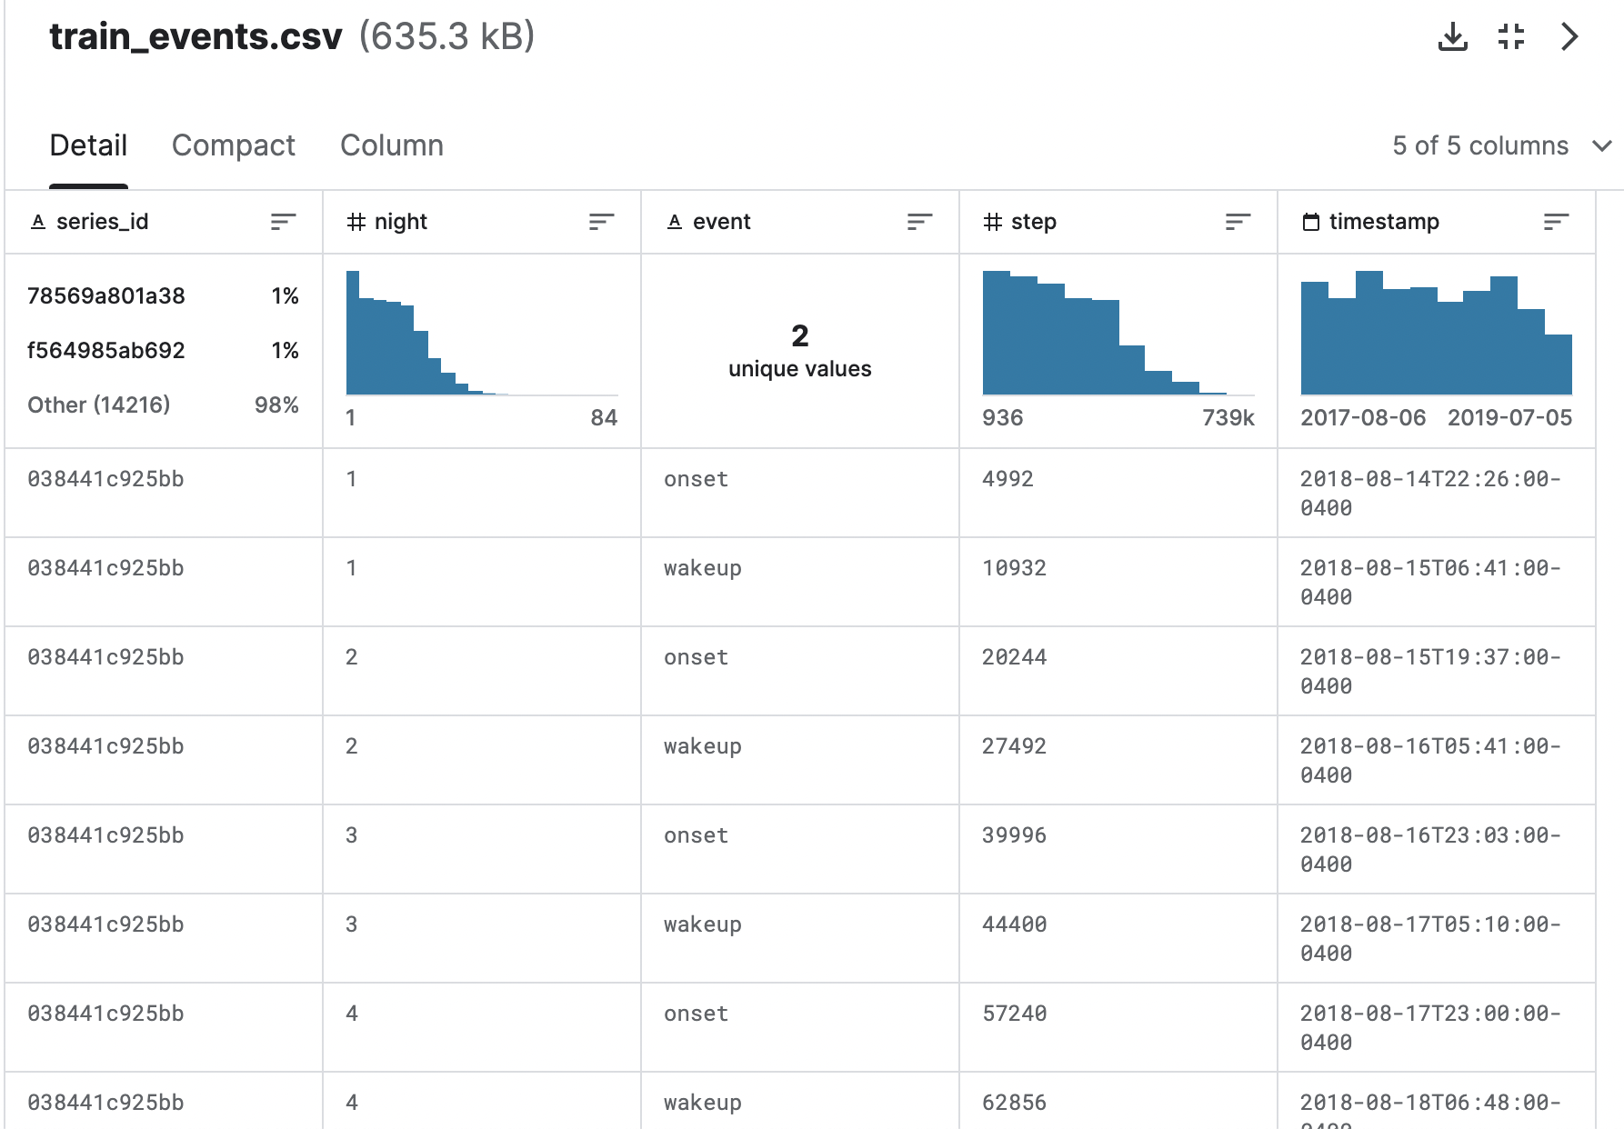
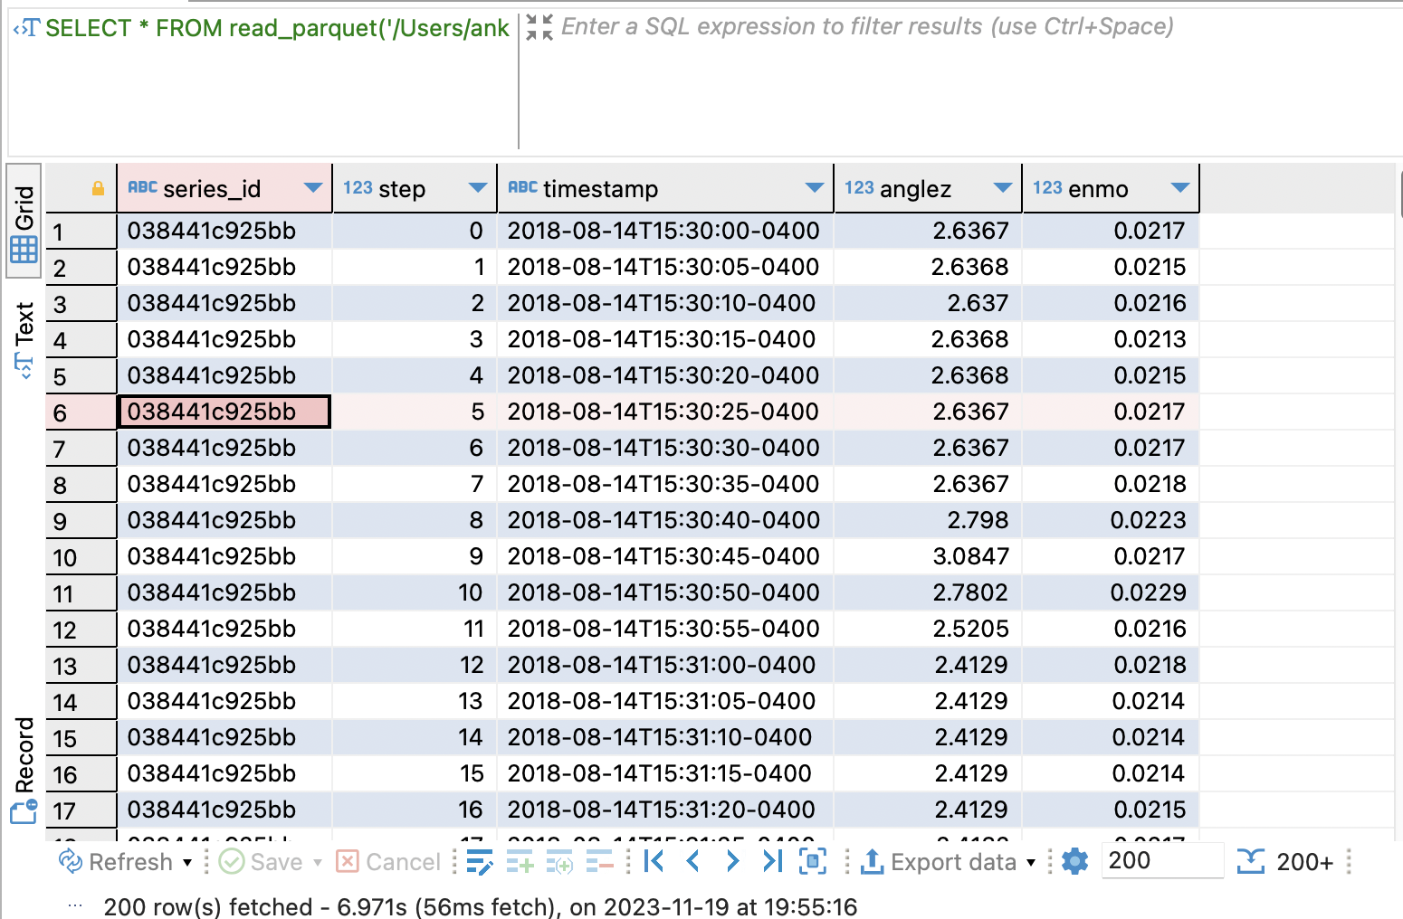

Slide 7
Data Cleaning:
Cleaning in case of Missing values.
Cleaning noisy data, where noise is a random or variance error.
Cleaning with Data discrepancy detection and Data transformation tools.
series_copy = train_series.copy() events_copy = train_events.copy()
_train_series = series_copy[series_copy['series_id']==series_id] _train_events = events_copy[events_copy['series_id']==series_id] _train_series.index = pd.to_datetime(_train_series['timestamp'], utc=True)#indexing means interchanging the column for standardisation _train_events.index = pd.to_datetime(_train_events['timestamp'], utc=True)

Slide 8


Do you want to Integrate Data? which one?

Slide 9
Data Selection of course ! Regression in future decision Tree
Sleep detect
Willing to sleep
Willing to wake up
Awake
sleep

Slide 10
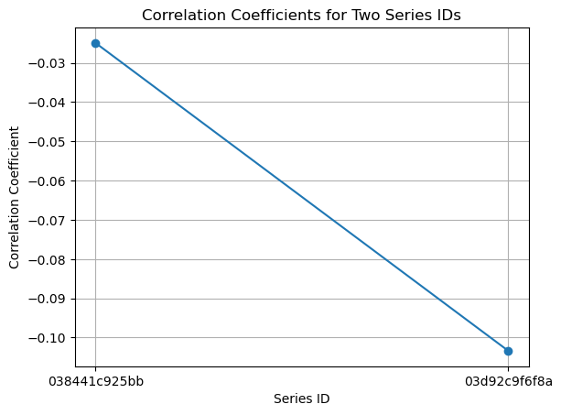
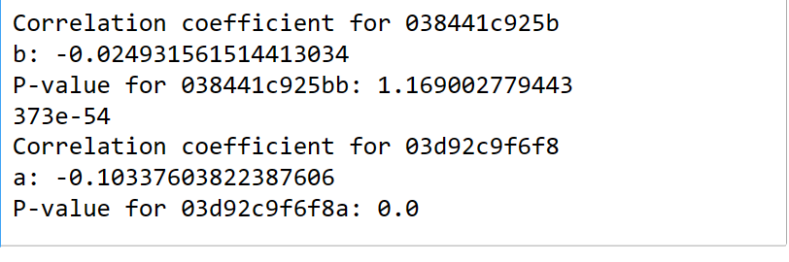

Are those vital features correlated? Let’s See!
Sadly or happily
This value indicates a very weak negative correlation between the two variables.
The negative sign suggests that as one variable increases, the other tends to decrease slightly, but the correlation is not strong.
Do not get tired we found something interesting, Let’s see next Slide.

Slide 11

Easy Peasy Then we will work on one
Of them
P-value: 1.169002779443373e-54The p-value is extremely small (close to 0), indicating strong evidence against the null hypothesis.
In practice, this often means that the observed correlation is statistically significant.
For series ID 03d92c9f6f8a:
Correlation Coefficient: -0.10337603822387606
Similar to the first series ID, this value also indicates a very weak negative correlation.
P-value: 0.0
The p-value is reported as 0.0, which is likely due to numerical precision limitations.
This implies very strong evidence against the null hypothesis, supporting the significance of the observed correlation.

Slide 12

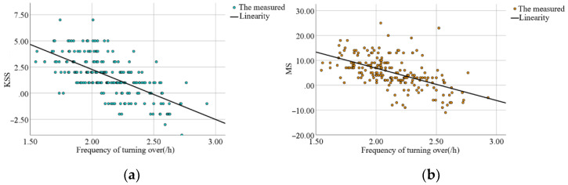
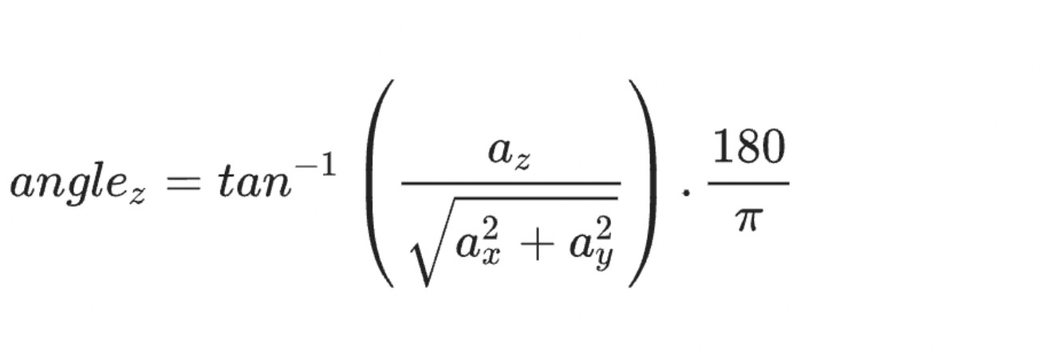
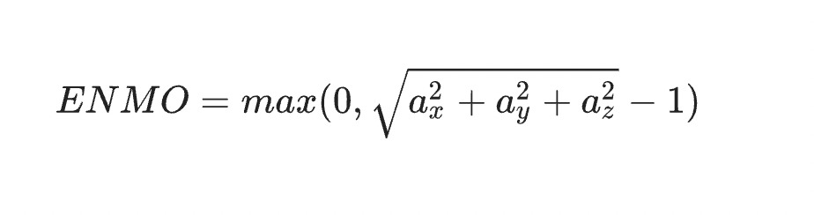
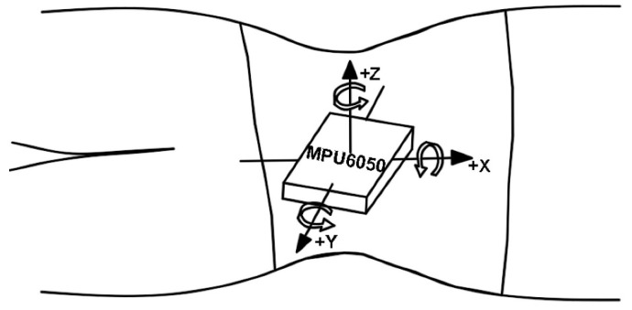
Let’s ask From Mrs. Bee
It has been proved by:
The Relationship between Sleeping Position and Sleep Quality: A Flexible Sensor-Based StudyYuan Zhang,¹ Aiping Xiao,^{1,*} Tianhao Zheng,¹ Huafei Xiao,² and Ruiyan Huanghttps://www.ncbi.nlm.nih.gov/pmc/articles/PMC9416198/1

Slide 13

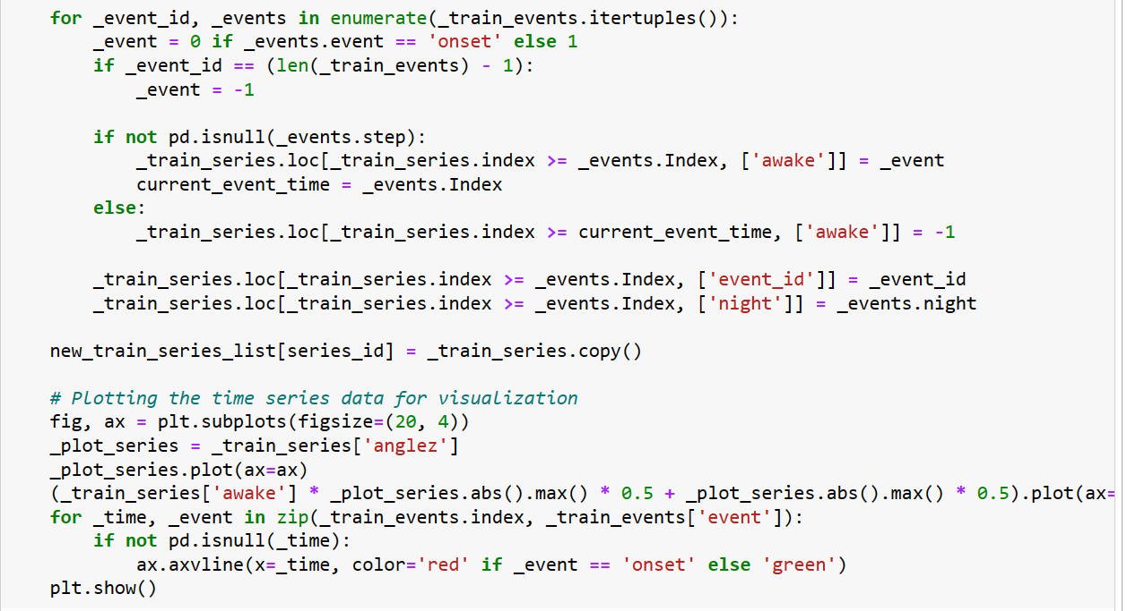
Pattern Evaluation not Completely but Future it will be

Slide 14
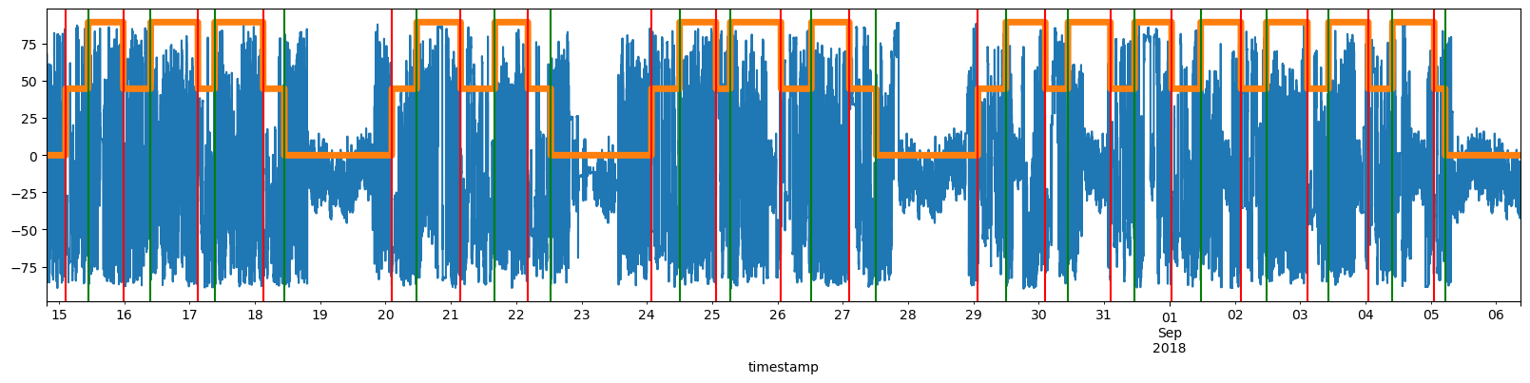

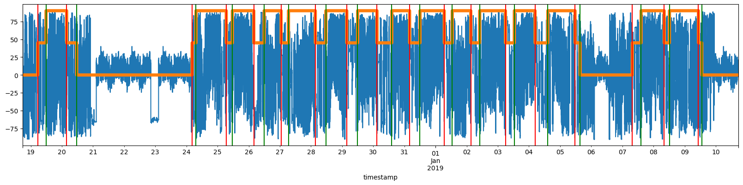
Here we will show you the pattern only in two series_id

Slide 15
What we expect to do for Future?
Estimating the average of enmo or anglez for prediction
For modeling
Event Probability
LCM or Decision Tree
We should test both!

Slide 16
Difficulty Faced:
The files we downloaded from Kaggle was in the format of ".parquet", we could access the file in DBeaver.
Changes were made for the attributes from String to Timestamp (Date).

Slide 17

Thanks For Watching

